Slide 1
Front End Engineering
Project - 1
Team Details:
Gaurav Luthra (2210990317)
Gaurav Kumain (2210990319)
Gopal Shrivastava (2210990327)
Faculty Coordinator:
Parul Gehelot
Chitkara University Institute of Engineering and Technology,
Chitkara University, Punjab

Slide 2
Contents
Introduction
Problem Statement
Technical Details
Key Features
Project Highlights
Conclusion
References/Links used

Slide 3
Introduction
Movie Recommendation System
Rotten Potatoes🥔
Gaurav Luthra (2210990317)
Gaurav Kumain (2210990319)
Gopal Shrivastava (2210990327)
Made By:

Slide 4
Problem Statement
"How can we effectively recommend movies to users in a movie recommendation system like Rotten Potatoes when faced with sparse user data, particularly when users have only purchased a few movies each?“
This question addresses the challenge of sparse user data in the context of building a movie recommendation system and prompts exploration into methods to improve recommendations despite limited individual user interactions with the system.
.

Slide 5

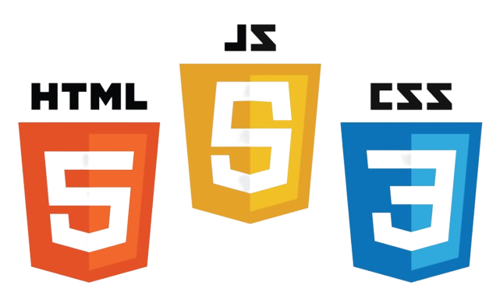


Technical Details
We employed HTML, CSS, and Bootstrap for crafting the user interface, and JavaScript for retrieving data from APIs.
Our choice of editor was Visual Studio Code, and we utilized Git and GitHub for collaborative work.
Netlify served as our hosting platform.
Ajax is an Asynchronous Javascript.

Slide 6
Key Features
1.Intuitive User Interface: Our website offers an intuitive and user-friendly interface, enabling effortless exploration of movie details. Users can easily access comprehensive information, enhancing their browsing experience.
2.Dynamic Filtering Options: Enhancing the search experience, our platform features dynamic filtering options. Users can refine their search by specifying criteria such as movie year and genre, ensuring precise and tailored results based on individual preferences.
3.Efficient Data Retrieval with API Integration: Leveraging JavaScript, we've seamlessly integrated API calls to fetch real-time movie data. This ensures our users have access to the latest information, maintaining the relevance and accuracy of details presented on the website.
Optimized Collaboration and Version Control: Supporting our development process, we efficiently use Visual Studio Code, Git.

Slide 7
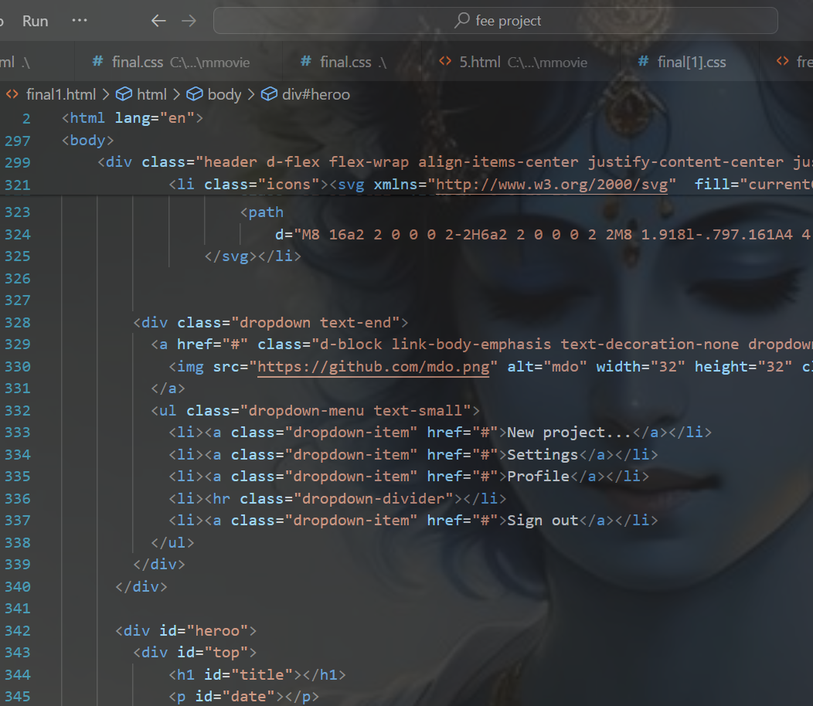
Project Highlights 1
HTML CODE SNIPPETS:

Slide 8
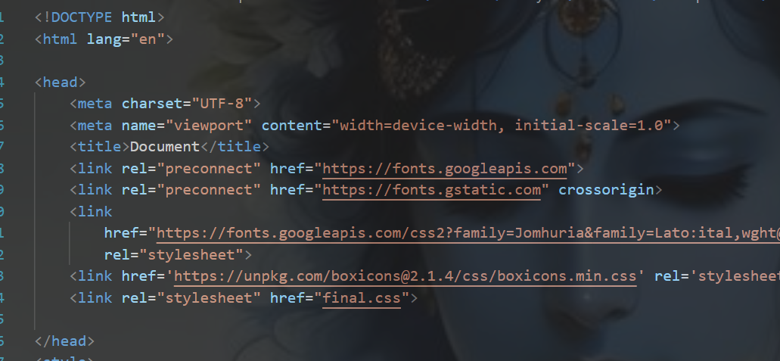
Project Highlights 1

Slide 9
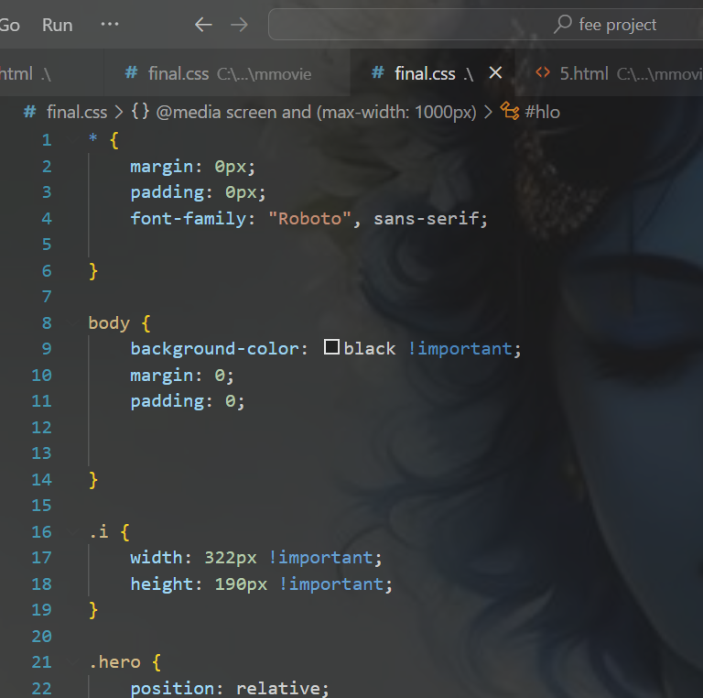
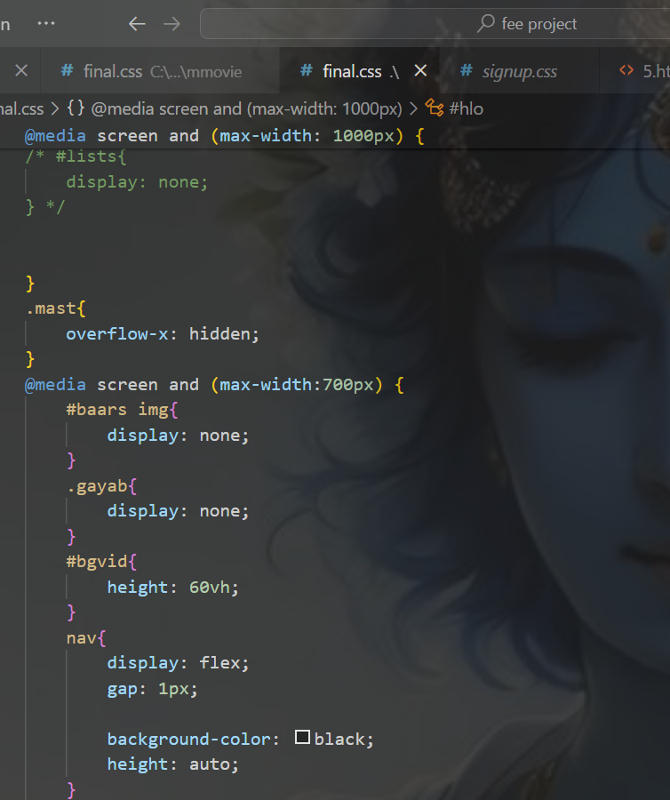
Project Highlights 2
CSS CODE SNIPPETS:

Slide 10
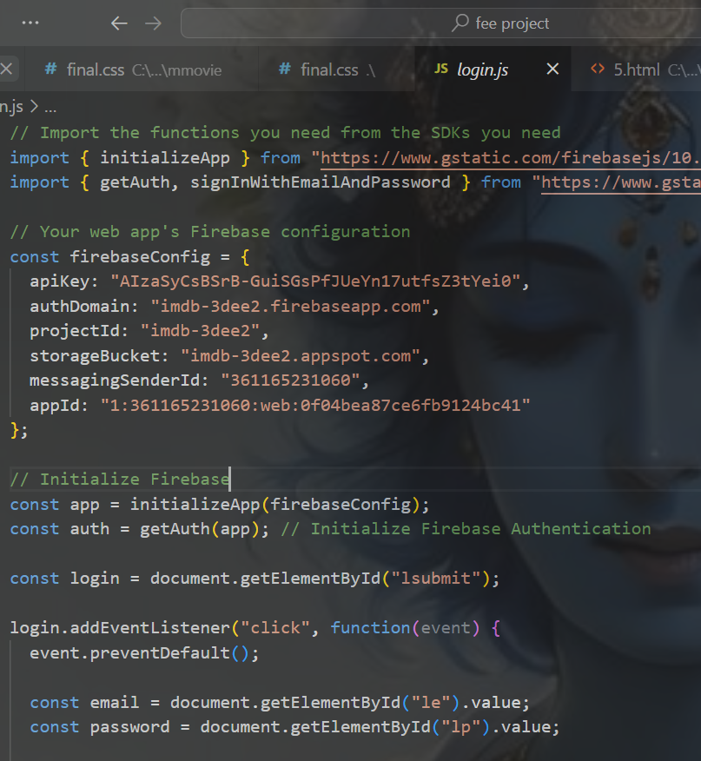
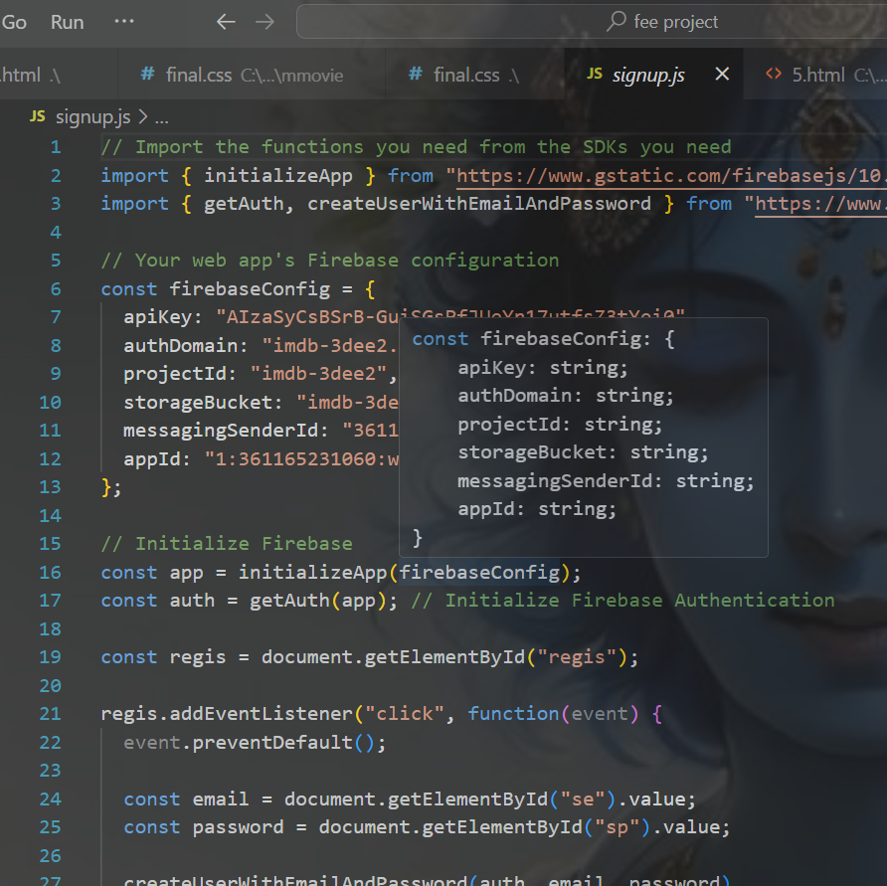
Project Highlights 2

Slide 11
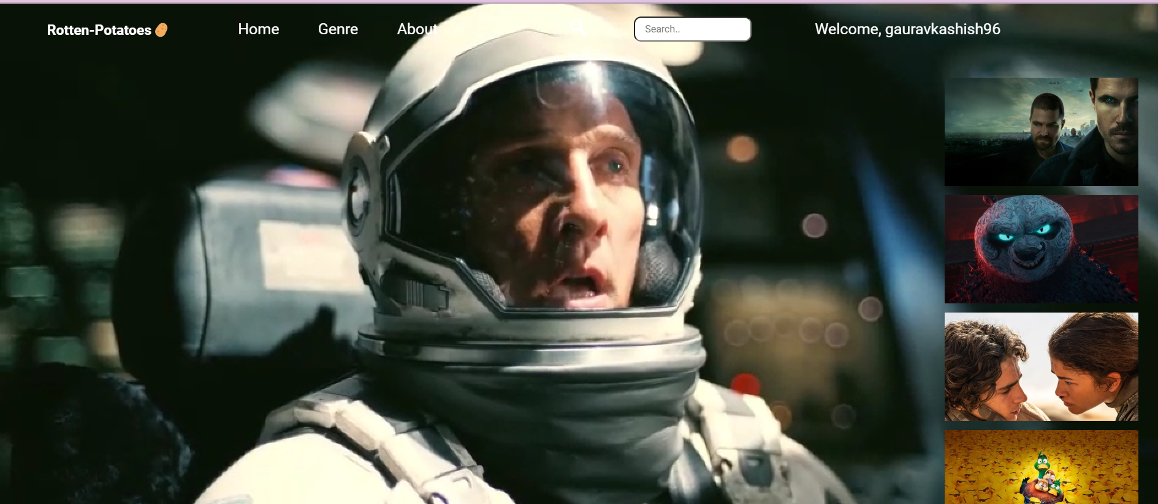
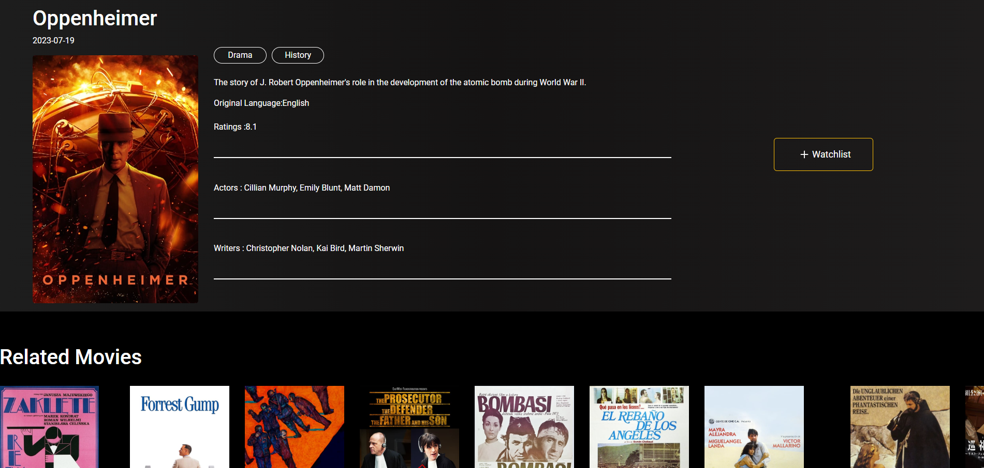
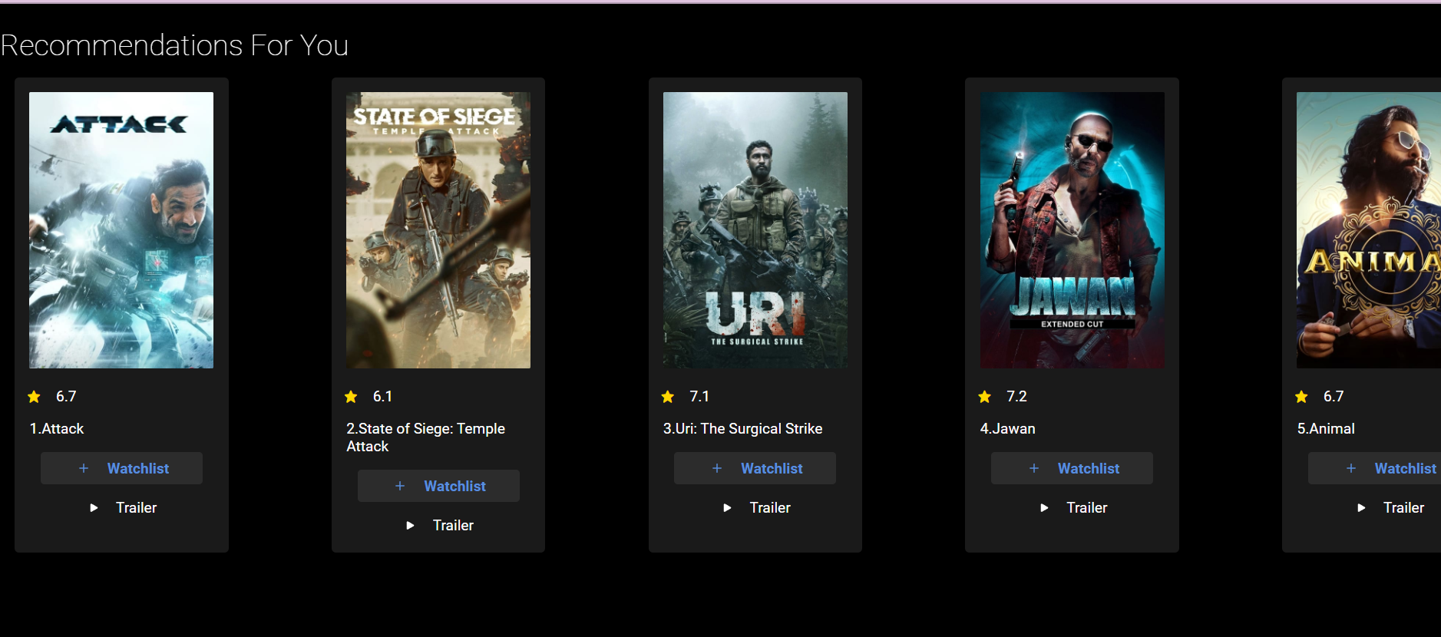
Conclusion
.

Slide 12
References/Links used
WIKIPEDIA- https://www.wikipedia.org/
W3SCHOOLS-https://www.w3schools.com/
IMDB:https://www.imdb.com/
OMDB:https://www.omdbapi.com/
TMBD:https://www.themoviedb.org/

Slide 13
Thank You

